Slide 1
Storage and File Structure

Slide 2
Introduction to Database
Storage and File Structure
Overview of Physical Storage Media（物理介质）
Magnetic Disks
RAID（独立磁盘冗余阵列）
Tertiary Storage （第三级存储）
Storage Access
File Organization（文件组织）
Organization of Records in Files（文件中记录的组织）
Data-Dictionary Storage（数据字典存储）

Slide 3
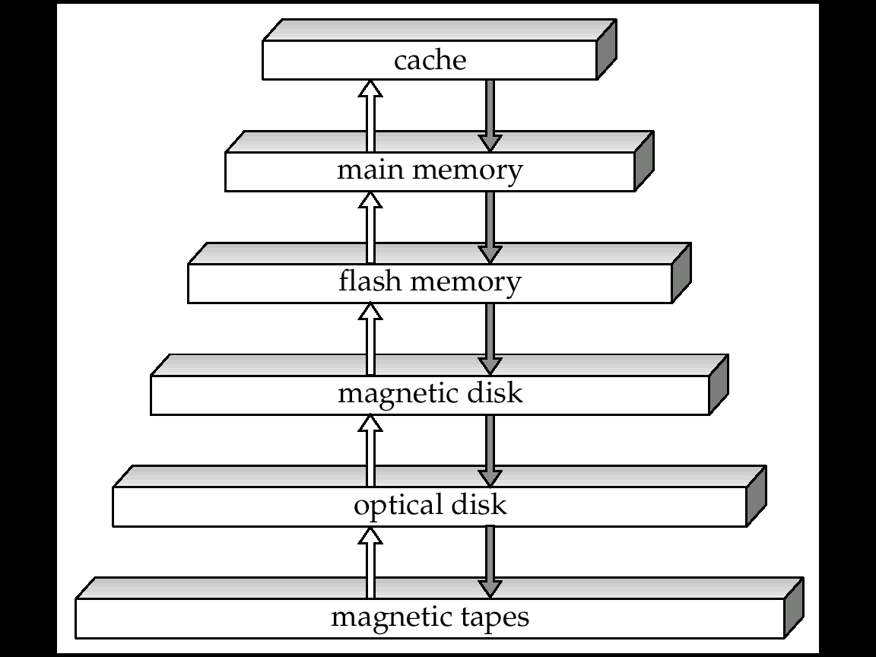
11.1 Physical Storage Media: Overview
Primary storage:
Fastest media but volatile（易失）
E.g. Cache, Main memory（高速缓冲存储器和主存储器）
Secondary storage:
next level in hierarchy, on-line storage
non-volatile（非易失）, moderately fast access time
E.g. Flash memory, Magnetic disks（闪存和磁盘）
Tertiary storage:
lowest level in hierarchy,
non-volatile, slow access time
also called off-line storage
E.g. Optical storage, Magnetic tape（光盘和磁带）
Storage Hierarchy

Slide 4
Storage Media: Classification
Speed with which data can be accessed
Cost per unit of data
Reliability（可靠性）
data loss on power failure or system crash
physical failure of the storage device
Volatile vs. Non-Volatile （易失性）
Volatile storage: loses contents when power is switched off
Non-Volatile storage:
Contents persist even when power is switched off.
Includes secondary and tertiary storage, and batter-backed up main-memory.

Slide 5
Storage Media: Cache , Main Memory
Cache:
fastest and most costly
Volatile
managed by the computer system hardware.
Main Memory:
fast access (10s to 100s of nanoseconds; 1 nanosecond = 10^{–9} seconds)
generally too small (or too expensive) to store the entire database
Volatile

Slide 6
Storage Media: Flash Memory
Flash Memory
Data survives power failure
Data can be written at a location only once, but location can be erased and written to again
Can support only a limited number of write/erase cycles.
Reads are roughly as fast as main memory
But writes are slow (few microseconds), erase is slower
Cost per unit of storage roughly similar to main memory
Widely used in embedded devices such as digital cameras

Slide 7
Storage Media: Magnetic Disk
Magnetic Disk:
Data is stored on spinning disk, and read/written magnetically
Primary medium for the long-term storage of data（二级存储的主要形式）
typically stores entire database.
Can direct-access – possible to read data on disk in any order
Capacities range up to roughly 4 TB currently
Growing constantly and rapidly with technology improvements
Survives power failures and system crashes
disk failure can destroy data, but is very rare
Data must be moved from disk to main memory for access, and written back for storage
Much slower access than main memory

Slide 8
Storage Media: Optical Storage
Optical Storage:
non-volatile, data is read optically from a spinning disk using a laser
CD-ROM (640 MB) and DVD (4.7 to 17 GB) most popular forms
Write-one, read-many (WORM) optical disks used for archival storage (CD-R and DVD-R)
Multiple write versions also available (CD-RW, DVD-RW, and DVD-RAM)
Reads and writes are slower than with magnetic disk

Slide 9
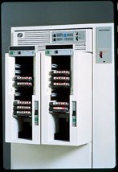
Storage Media: Tape
Tape Storage:
non-volatile, used primarily for backup (to recover from disk failure), and for archival data
sequential-access – much slower than disk
very high capacity (40 to 300 GB tapes available)
tape can be removed from drive ⇒ storage costs much cheaper than disk, but drives are expensive

Slide 10
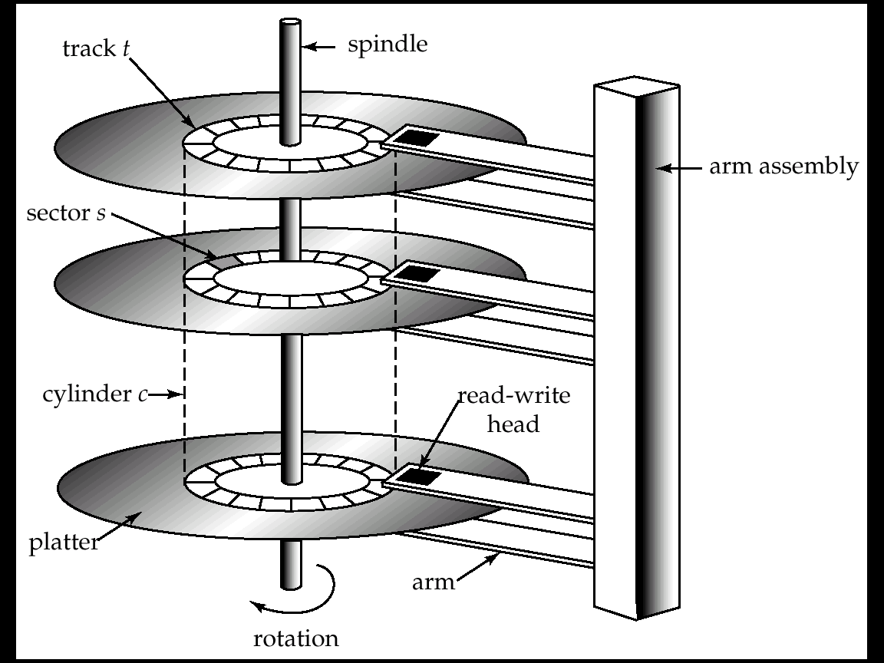

Magnetic Hard Disk Mechanism
11.2 Magnetic Disks
主轴
磁道
磁盘臂组件
扇区s
柱面
读写头
盘片
磁盘臂
旋转
NOTE: Diagram is schematic, and simplifies the structure of actual disk drives

Slide 11
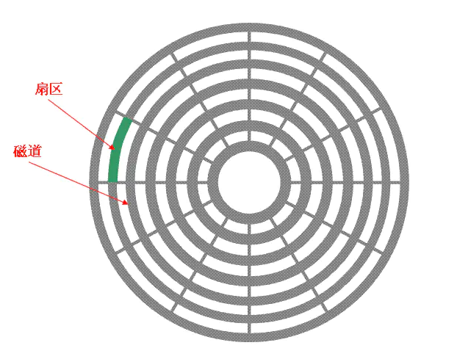
Magnetic Hard Disk Mechanism
11.2 Magnetic Disks

Slide 12
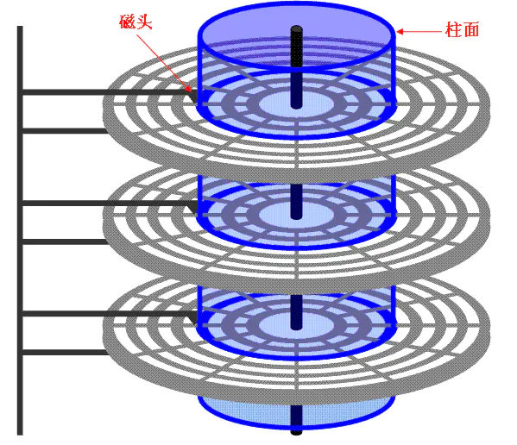
Magnetic Hard Disk Mechanism
11.2 Magnetic Disks

Slide 13
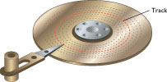
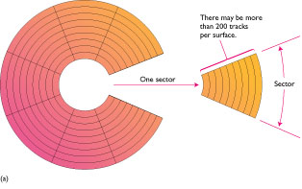
11.2.1 Characteristics of Disks（物理特征）
Read-write head （读写头）
Positioned very close to the platter surface (almost touching it)
Reads or writes magnetically encoded information.（磁化写入）
Tracks（磁道）: Surface of platter divided into circular tracks
Over 50,000 tracks per platter on typical hard disks
Sectors（扇区）: Each track is divided into sectors
A sector is the smallest unit of data that can be read or written.
Sector size typically 512 bytes
Typical sectors per track: 500 (on inner tracks) to 1000 (on outer tracks)
To read/write a sector
disk arm swings to position head on right track
platter spins continually; data is read/written as sector passes under head

Slide 14
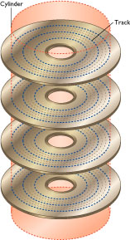
Characteristics of Disks (cont.)
Head-disk assemblies （磁头-磁盘装置）
multiple disk platters on a single spindle（轴）
one head per platter, mounted on a common arm（磁盘臂）.
Cylinder（柱面）: Cylinder i consists of i^{th} track of all the platters
Disk controller （磁盘控制器）
interfaces between the computer system and the disk drive hardware.（系统和硬件之间的接口）
accepts high-level commands to read or write a sector
initiates actions such as moving the disk arm to the right track and actually reading or writing the data
Computes and attaches checksums（校验和） to each sector to verify that data is read back correctly
Performs remapping of bad sectors（坏扇区的重映射）

Slide 15
11.2.2 Performance Measures of Disks
Performance Measures of Disks
Access time访问时间, Data-transfer rate数据传输率
Mean time to failure (MTTF) 平均故障时间
Access time（访问时间）
the time it takes from when a read or write request is issued to when data transfer begins.
Consists of:
Seek time 寻道– time it takes to reposition the arm over the correct track.
Average seek time is 1/2 the maximum seek time. if all tracks had the same number of sectors
ignore the time to start and stop arm movement
4 to 10 milliseconds on typical disks
Rotational latency 旋转等待– time it takes for the sector to be accessed to appear under the head.
Average latency is 1/2 of the worst case latency.
4 to 11 milliseconds on typical disks (5400 to 15000 r.p.m.)

Slide 16
Performance Measures (cont.)
Data-transfer Rate（数据传输率）
the rate at which data can be retrieved from or stored to the disk.
I.e. data be transferred between disk and main memory
20 to 100 MB per second is typical
Multiple disks may share a controller, so rate that controller can handle is also important（一个接口的传输速率由连接到这个接口的所有磁盘共享）
E.g. ATA-5: 66 MB/sec, SATA: 150 MB/sec, Ultra 320 SCSI: 320 MB/s
Mean Time to Failure (MTTF)（平均故障时间）
the average time the disk is expected to run continuously without any failure.
Typically 3 to 5 years

Slide 17
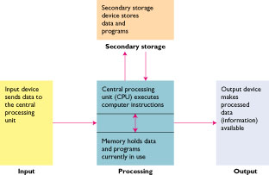
11.2.3 Optimization of Disk-Block Access
Access to data in disk is several orders of magnitude slower than access to data in main memory
Block
a contiguous sequence of sectors from a single track
data is transferred between disk and main memory in blocks
sizes range from 512 bytes to several kilobytes
Smaller blocks: more transfers from disk
Larger blocks: more space wasted due to partially filled blocks
Typical block sizes today range from 4 to 16 kilobytes
Study on techniques for improving the speed of access to blocks on disk

Slide 18
Disk-Block Access: Method 1, 2
Method 1: Buffering of Blocks（缓冲）
Using buffer to store blocks to satisfy future requests
Section 11.5 will discuss more
Method 2: Disk-Arm-Scheduling （调度-磁盘臂调度）
algorithms order pending accesses to tracks so that disk arm movement is minimized
Elevator Algorithm : move disk arm in one direction (from outer to inner tracks or vice versa), processing next request in that direction, till no more requests in that direction, then reverse direction and repeat
电梯算法

Slide 19
Disk-Block Access: Method 3
Method 3: File organization（文件组织）
Store related information on the same or nearby cylinders（柱面）
Optimize block access time by organizing the blocks to correspond to how data will be accessed
Defragment（磁盘碎片整理程序）:
Files may get fragmented碎片化over time
E.g. if data is inserted to/deleted from the file
Or free blocks on disk are scattered（分散的）, and newly created file has its blocks scattered over the disk
Sequential access to a fragmented file results in increased disk arm movement
Some systems have utilities to defragment the file system, in order to speed up file access
Re- organization

Slide 20
11.3 RAID
RAID (Redundant Arrays of Independent Disks，冗余独立磁盘阵列)
disk organization techniques that manage a large numbers of disks, providing a view of a single disk of
high capacity and high speed by using multiple disks in parallel, and （高性能-并行）
high reliability by storing data redundantly, so that data can be recovered even if a disk fails （可靠性-冗余）
Originally a cost-effective alternative to large, expensive disks
I in RAID originally stood for ``inexpensive’’
Today RAIDs are used for their higher reliability and bandwidth.
The “I” is interpreted as independent

Slide 21
11.4 Tertiary Storage
Optical Disks
Compact disk-read only memory (CD-ROM)
Digital Video Disk (DVD)
Record once versions (CD-R and DVD-R)
Magnetic Tapes

Slide 22
11.4.1 Optical Disks（光盘）
Compact disk-read only memory (CD-ROM)
Disks can be loaded into or removed from a drive
High storage capacity (640 MB per disk)
High seek times or about 100 msec (optical read head is heavier and slower)
Higher latency (3000 RPM) and lower data-transfer rates (3-6 MB/s) compared to magnetic disks
Digital Video Disk (DVD) （数字视频光盘）
DVD-5 holds 4.7 GB , and DVD-9 holds 8.5 GB
DVD-10 and DVD-18 are double sided formats with capacities of 9.4 GB and 17 GB
Record once versions (CD-R and DVD-R) are becoming popular
data can only be written once, and cannot be erased.
high capacity and long lifetime; used for archival（档案的） storage
Multi-write versions (CD-RW, DVD-RW and DVD-RAM) also available

Slide 23
11.4.2 Magnetic Tapes（磁带）
Hold large volumes of data
Few GB for DAT (Digital Audio Tape) format, 10-40 GB with DLT (Digital Linear Tape) format, 100 GB+ with Ultrium format, and 330 GB with Ampex helical scan format
Transfer rates from few to 10s of MB/s
Currently the cheapest storage medium
Tapes are cheap, but cost of drives is very high
Very slow access time in comparison to magnetic disks and optical disks
limited to sequential access.
Some formats (Accelis) provide faster seek (10s of seconds)
Used mainly for backup,
Tape jukeboxes（自动磁带机） used for very large capacity storage
(terabyte (10¹² bytes) to petabye (10¹⁵ bytes)

Slide 24
Introduction to Database
CHAPTER 11
Storage and File Structure
Overview of Physical Storage Media
Magnetic Disks
RAID
Tertiary Storage
Storage Access
File Organization
Organization of Records in Files
Data-Dictionary Storage

Slide 25
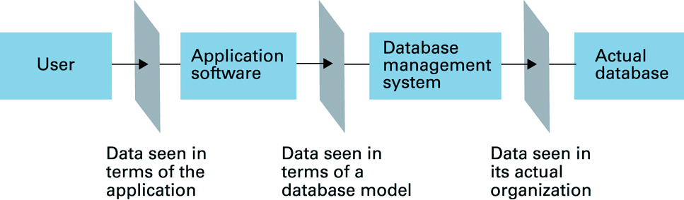
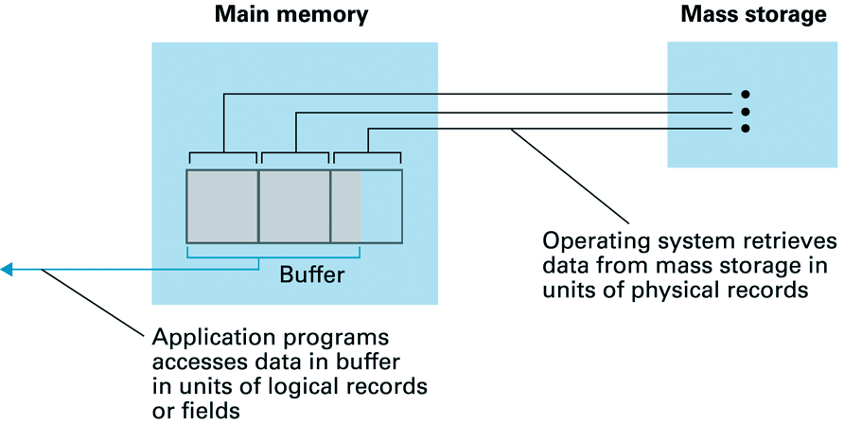
11.5 Storage Access
Database: is mapped into a number of files
A database file
is partitioned into fixed-length storage units called blocks.
Blocks are units of both storage allocation and data transfer.
Program
DISK
blocks
CPU

Slide 26
Storage Access (cont.)
Reduce the number of block transfers
Database system seeks to minimize the number of block transfers between the disk and memory. （最小磁盘和主存的传输次数）
We can reduce the number of disk accesses by keeping as many blocks as possible in main memory. （常驻主存）
Buffer（缓冲区）
portion of main memory available to store copies of disk blocks.
Buffer manager
subsystem responsible for allocating buffer space in main memory.

Slide 27
11.5.1 Buffer Manager
Programs call on the Buffer Manager when they need a block from disk.
If the block is already in the buffer, the requesting program is given the address of the block in main memory（主存有）
If the block is not in the buffer, （主存无）
the buffer manager allocates space in the buffer for the block, replacing (throwing out) some other block, if required, to make space for the new block.
The block that is thrown out is written back to disk only if it was modified since the most recent time that it was written to/fetched from the disk.
Once space is allocated in the buffer, the buffer manager reads the block from the disk to the buffer, and passes the address of the block in main memory to requester.
Buffer-Replacement Policies

Slide 28
11.5.2 Buffer-Replacement Policies
Policy 1: First in first out (FIFO)
Policy 2: Least Recently Used (LRU)
Most operating systems replace the block by LRU strategy
Queries have well-defined access patterns (such as sequential scans), and a database system can use the information in a user’s query to predict future references
LRU can be a bad strategy for certain access patterns involving repeated scans of data
e.g. when computing the join of 2 relations r and s by a nested loops for each tuple tr of r do for each tuple ts of s do if the tuples tr and ts match …
先進先出
最近最少使用者先出

Slide 29
Buffer-Replacement Policies (cont.)
立即丢弃
Policy 3: Toss-immediate strategy – frees the space occupied by a block as soon as the final tuple of that block has been processed（循环-外层）
Policy 4: Most recently used (MRU) strategy –
Pinned（钉住） block – memory block that is not allowed to be written back to disk
system must pin the block currently being processed.
After the final tuple of that block has been processed, the block is unpinned（解除钉住）, and it becomes the most recently used block.
Other Policy : Buffer manager can use statistical information regarding the probability that a request will reference a particular relation
剛用者先出

Slide 30
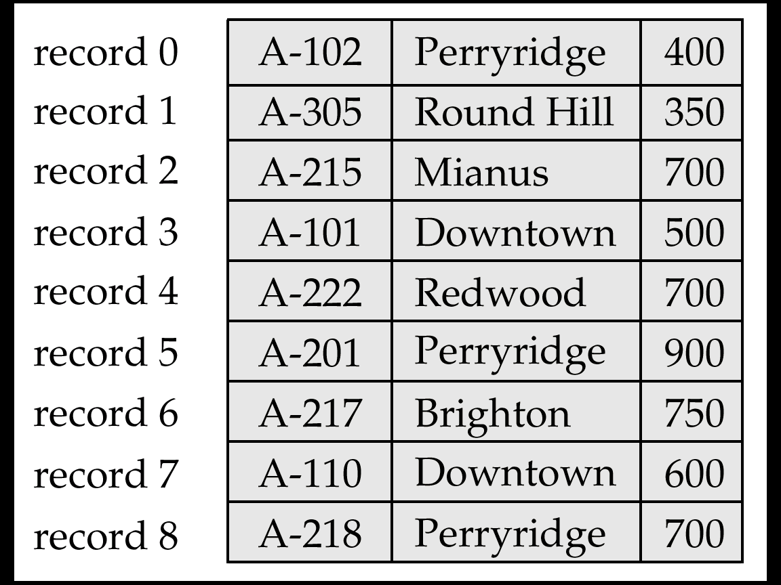

11.6 File Organization
The database is stored as a collection of files.
Each file is a sequence（序列） of records.
A record is a sequence of fields.
File Organization
How to organize the relations (records) and store in a disk?
The ways of representing logical data model (tables) by using files (in disk)
Disk File
table

Slide 31
11.6.1 Fixed-Length Records
The Approach:
Assume record size is fixed
Each file has records of one particular type only
Different files are used for different relations
This case is easiest to implement

Slide 32
Fixed-Length Records (cont.)
Simple approach:
Store record i starting from byte n ∗ (i – 1), where n is the size of each record.（定位）
Record access is simple but records may cross blocks
Modification: do not allow records to cross block boundaries（不允许跨内部分存储记录）
Deletion of record i - Alternatives Methods: (see next pages)
Move All: move records i + 1, . . ., n to i, . . . , n – 1
Move Last One: move record n to i
Using Free List: do not move records, but link all free records on a free list

Slide 33
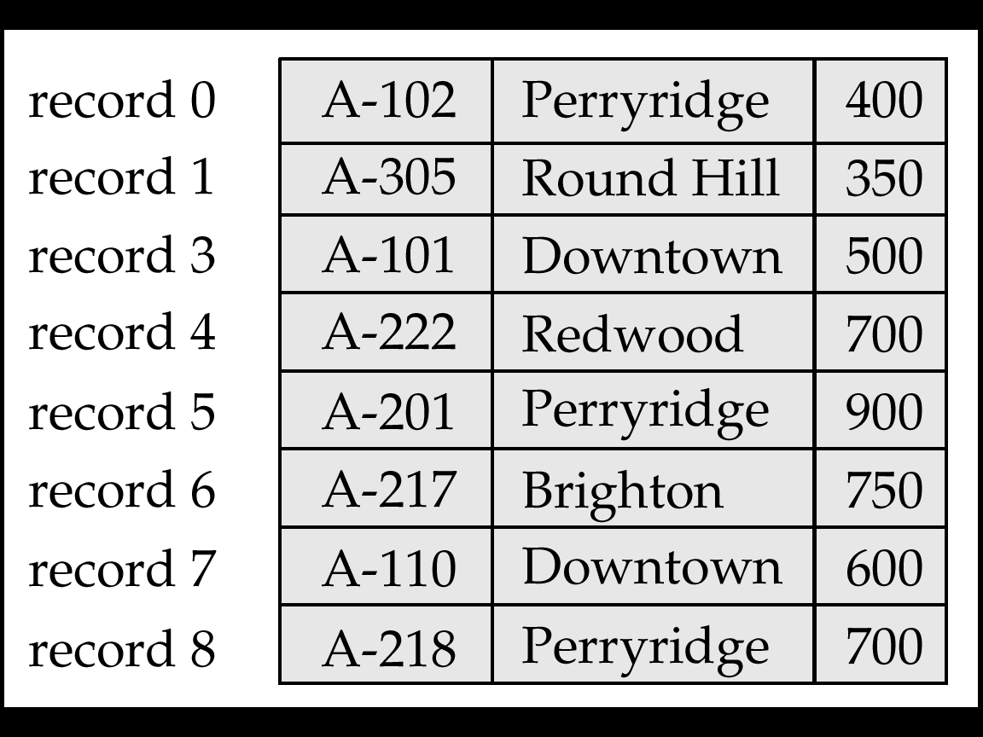
1) Move All: Record 2 deleted and all records moved
Fixed-Length Records Delete: Move All

Slide 34
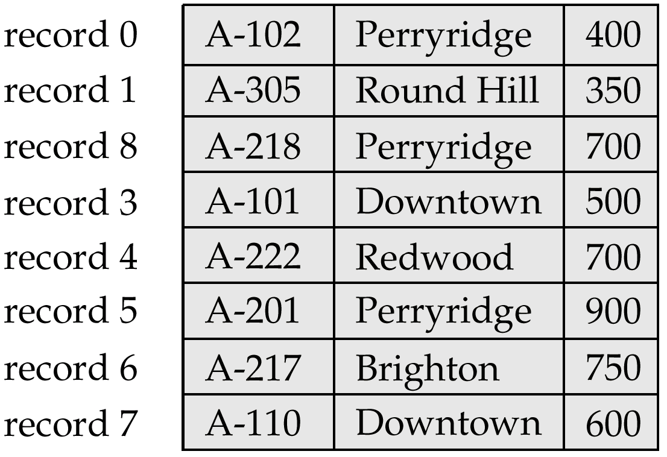
2) Move Last One: Record 2 deleted and final record moved
Fixed-Length Records Delete: Move Last One

Slide 35
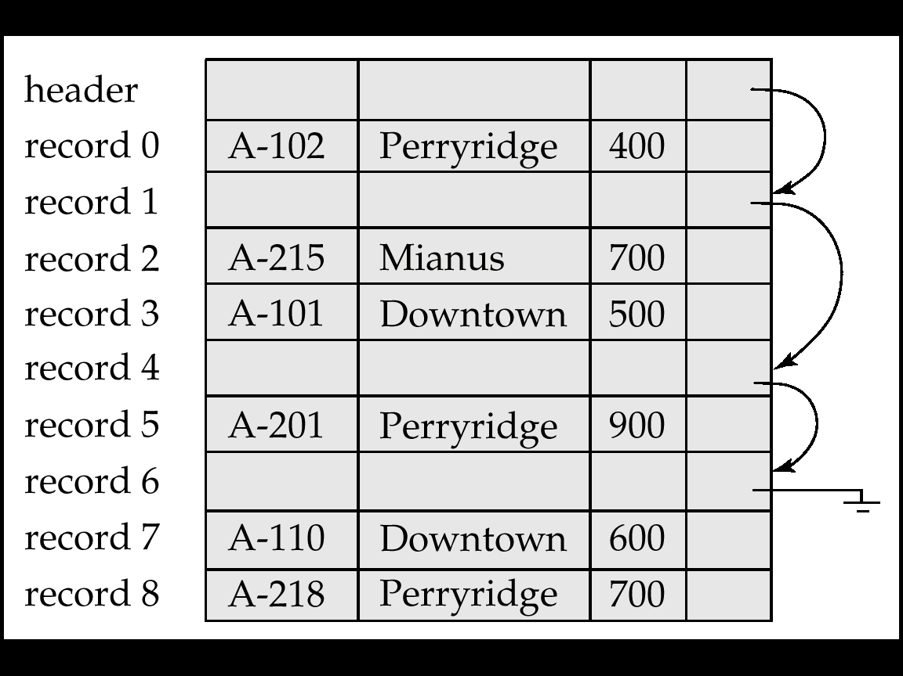
Fixed-Length Records Delete: Free List
Store the address of the first deleted record in the file header.
Use this first record to store the address of the second deleted record, and so on
Can think of these stored addresses as pointers since they “point” to the location of a record.
More space efficient representation: reuse space for normal attributes of free records to store pointers. (No pointers stored in in-use records.)
3) Using Free Lists

Slide 36
11.6.2 Variable-Length Records
Variable-length records arise in database systems in several ways:
Storage of multiple record types in a file. e.g. S, P, SP in a file（多类型）
Record types that allow variable lengths for one or more fields.（变长字段）
Representation Methods:
1) Byte String Representation
1. Basic Method
2. Slotted Page Method （分槽的页结构）
2) Fixed-Length Representation
1. Reserved Space Method（预留空间）
2. List Representation Method

Slide 37
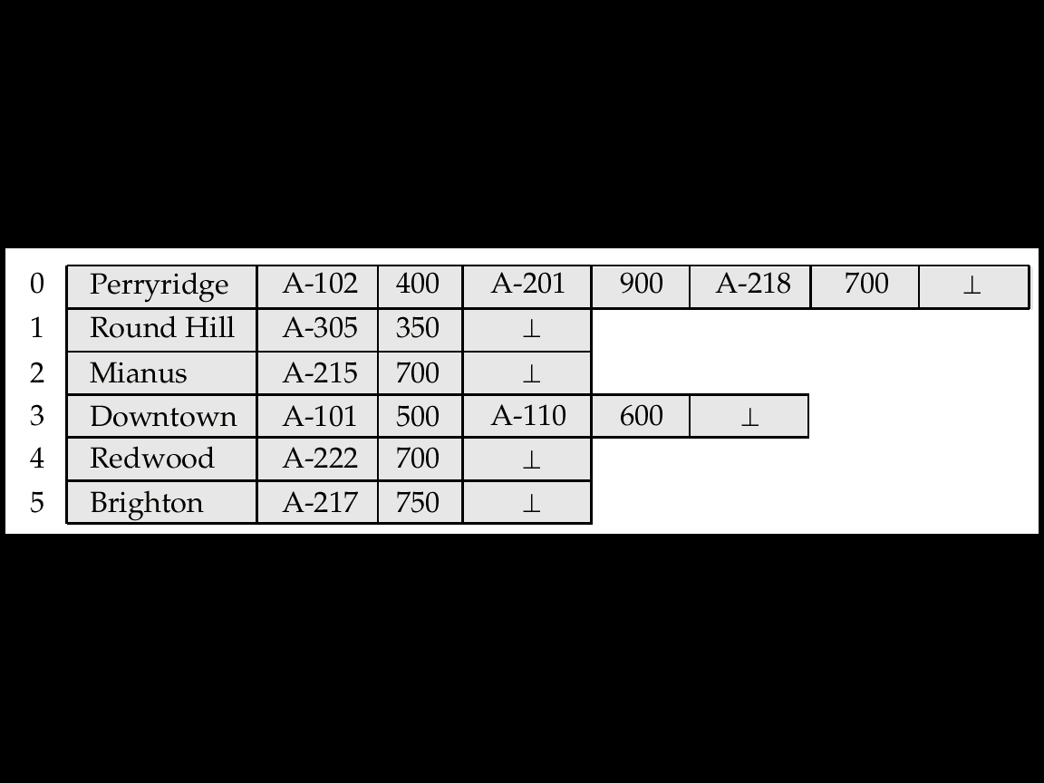
Byte-String Representation: Basic Method
Byte string representation: Basic Method
Attach an end-of-record (⊥) control character to the end of each record
Advantage:
Disadvantages:
Not easy to reuse space after a deletion
Difficulty with growth
Disk File
account

Slide 38
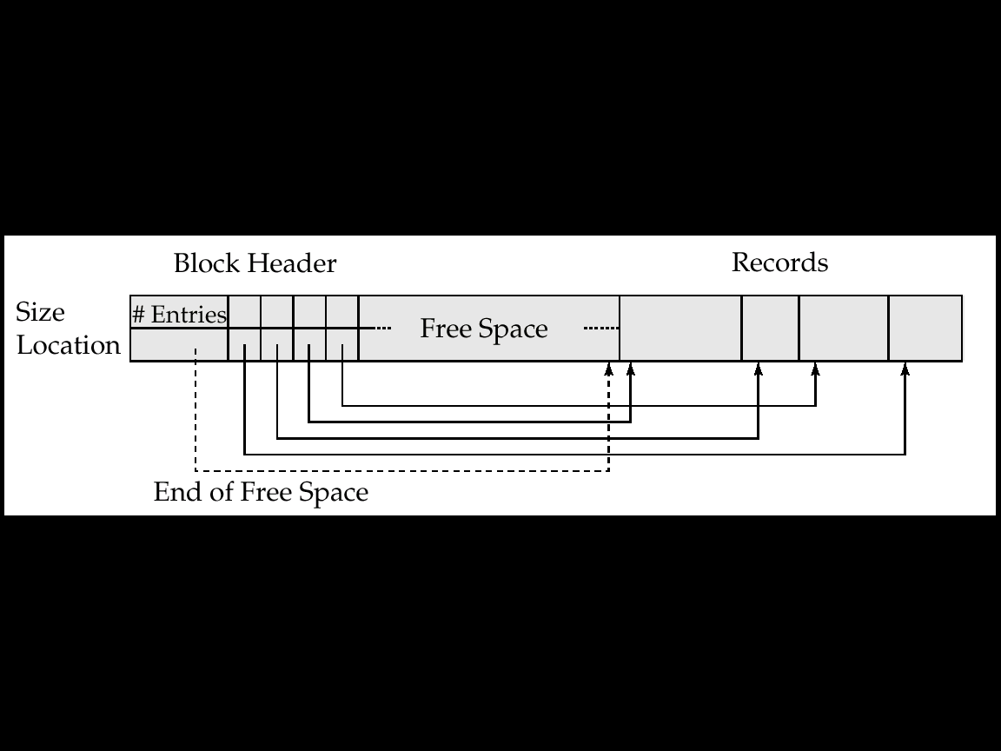
Byte-String Representation: Slotted Page 分槽页结构Method
槽
Slotted page header contains:
number of record entries（记录条目数）
end of free space in the block（空闲空间末尾处）
location and size of each record（记录位置和大小组成的数组）
Records can be moved around within a page to keep them contiguous with no empty space between them; entry in the header must be updated.
4

Slide 39
Byte-String Representation: Slotted Page Method (cont.)
Insertion
Deletion
How to insert?
How to delete?

Slide 40
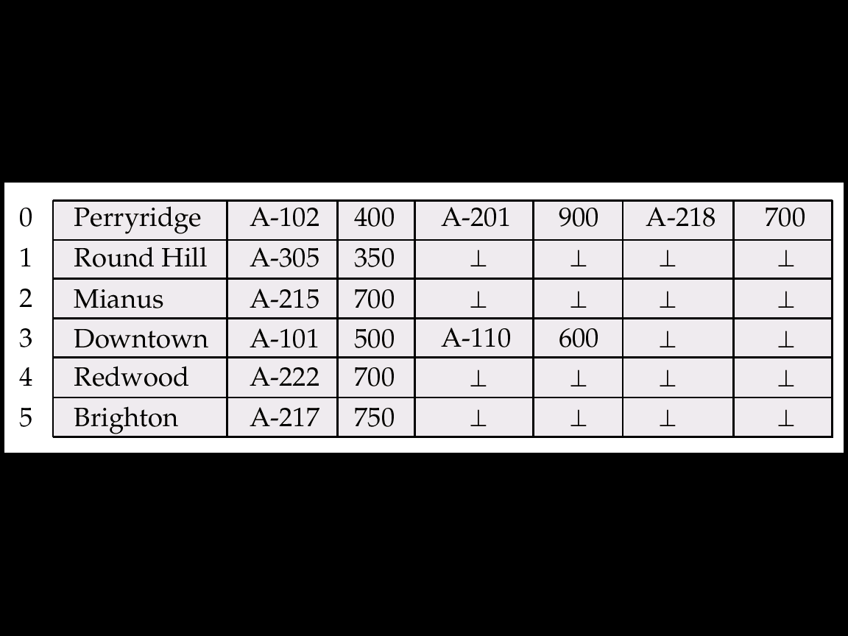
2) Fixed-length Representation
Fixed-length representation:
Reserved space
Pointers
1. Fixed-length Representation with Reserved Space
use fixed-length records of a known maximum length
unused space in shorter records filled with a null or end-of-record symbol.

Slide 41
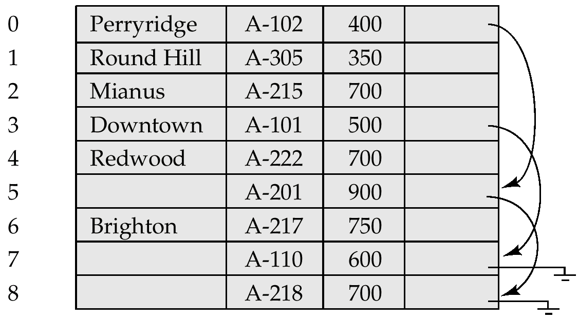
Fixed-length Representation with Pointer
2. Fixed-length Representation with Pointer
A variable-length record is represented by a list of fixed-length records, chained together via pointers.
Can be used even if the maximum record length is not known

Slide 42
11.7 Organization of Records in Files
Heap File堆文件 Organization（哪有空放哪）
a record can be placed anywhere in the file where there is space
Sequential File顺序文件 Organization（按搜索码顺序存放）
store records in sequential order, based on the value of the search key of each record
Hashing File散列文件 Organization （某些属性的散列函数）
a hash function computed on some attribute of each record;
the result specifies in which block of the file the record should be placed
Note: How to Store records of each relation
Generally, separate file is used to store the records of each relation
In a clustering file（聚集文件 ）organization records of several different relations can be stored in the same file
Motivation: store related records on the same block to minimize I/O

Slide 43
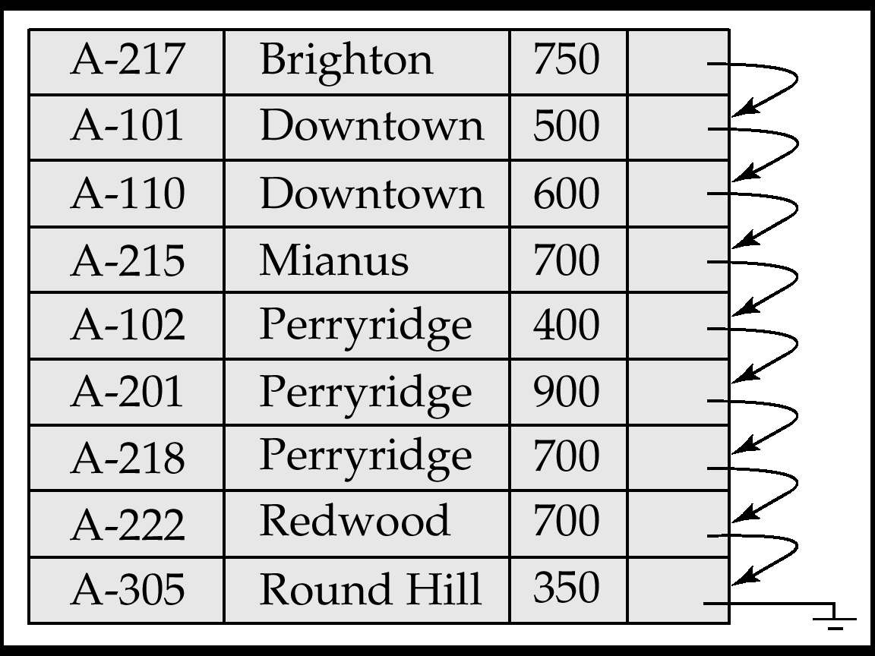
11.7.1 Sequential File Organization
Suitable for applications that require sequential processing of the entire file
The records in the file are ordered by a search-key
search-key

Slide 44
Sequential File Organization (cont.)
Deletion – use pointer chains
Note: Need to reorganize the file from time to time to restore sequential order
How to delete?

Slide 45
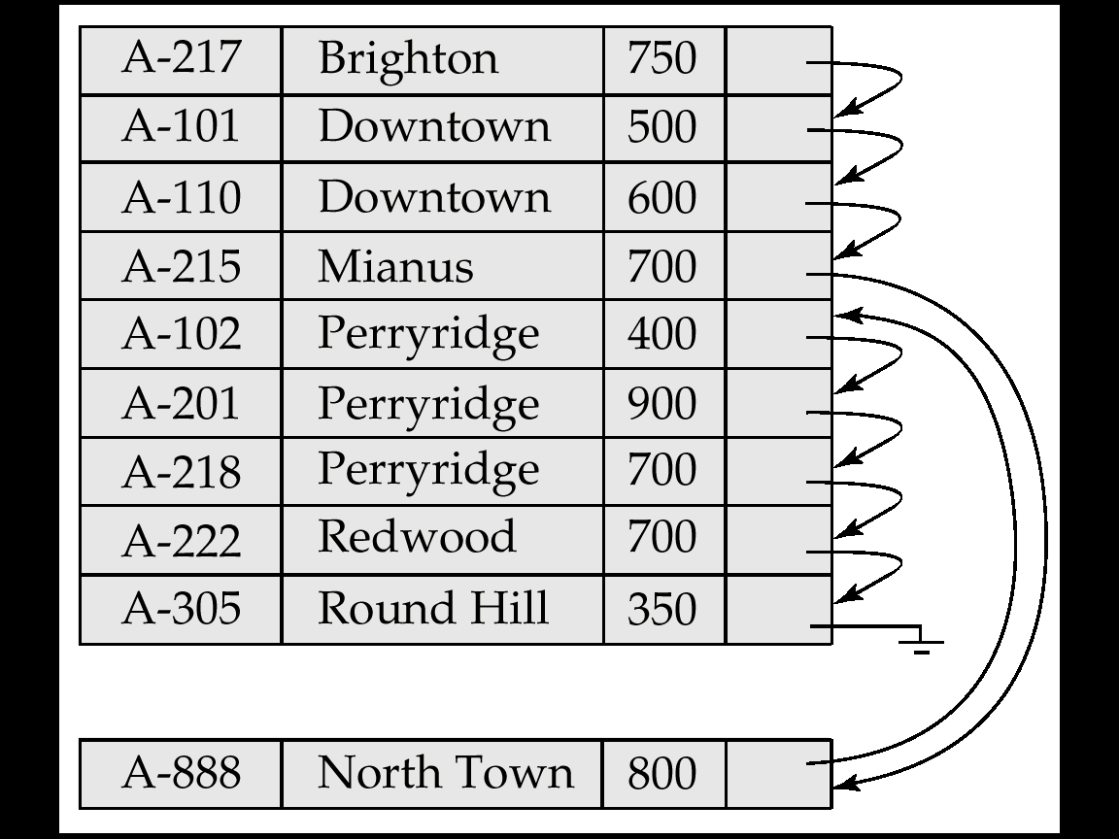
Sequential File Organization (cont.)
Insertion –locate the position where the record is to be inserted
if there is free space insert there
if no free space, insert the record in an overflow block
In either case, pointer chain must be updated
Note: Need to reorganize the file from time to time to restore sequential order
How to insert?
overflow block（溢出块）

Slide 46
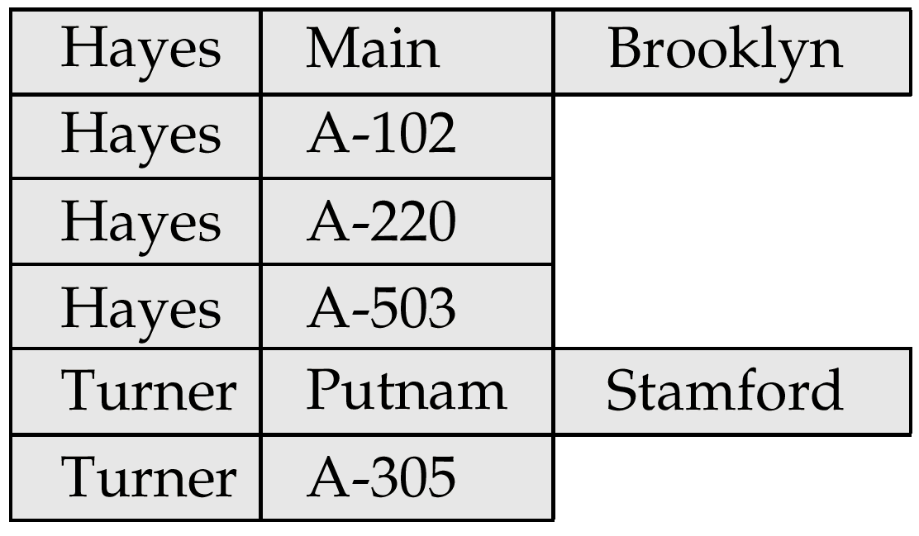
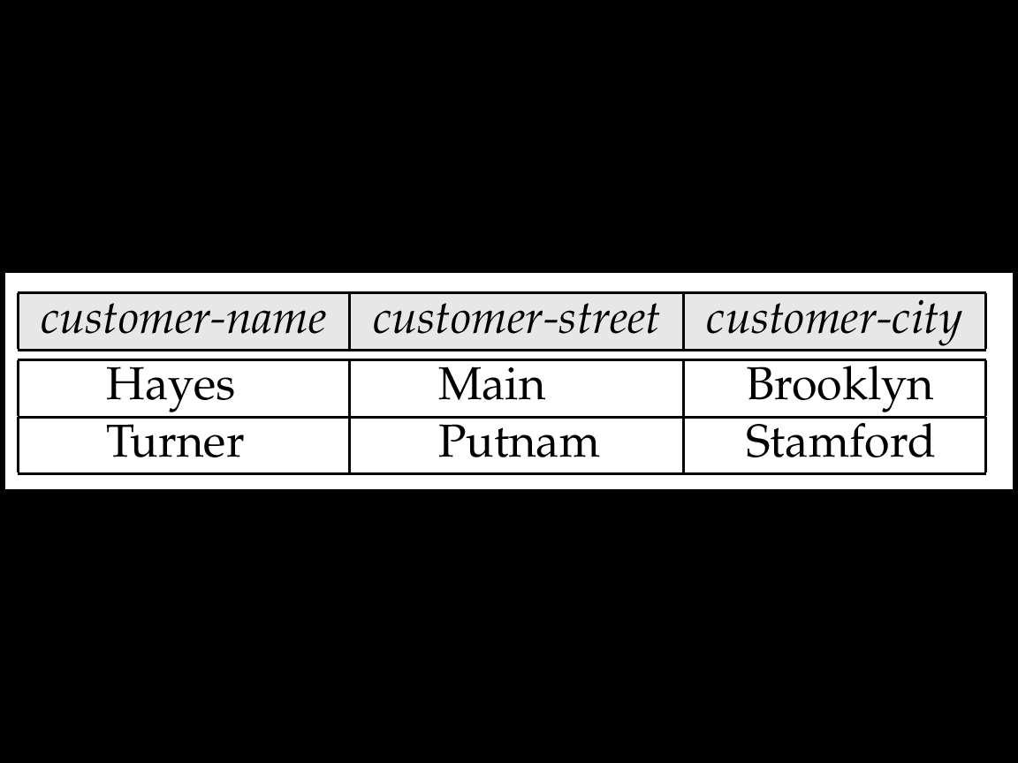
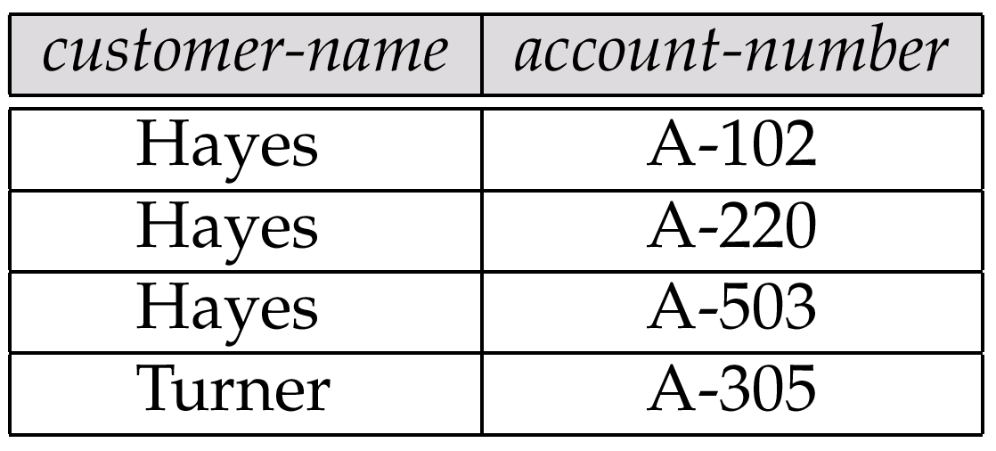
11.7.2 Clustering File Organization
Simple file structure stores each relation in a separate file
Can instead store several relations in one file using a clustering file organization
E.g., clustering organization of customer and depositor:
多表聚簇文件组织
customer
depositor
Fig. 11.19
good for queries involving depositor, customer, and for queries involving one single customer and his accounts
bad for queries involving only customer
results in variable size records

Slide 47
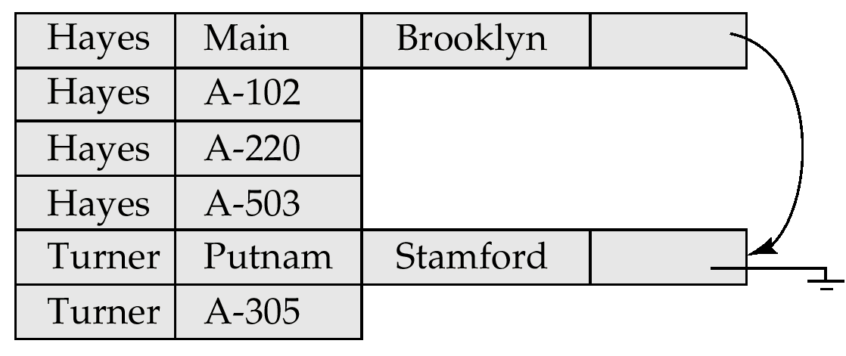
Clustering File Structure With Pointer Chains
Fig. 11.19
Without Pointer Chains
Fig. 11.20
With Pointer Chains

Slide 48
11.8 Data Dictionary Storage
Data Dictionary数据字典 (also called System Catalog)
stores metadata: that is, data about data
Contents of Data dictionary
Information about relations（关系的信息）
names of relation
names and types of attributes of each relation
names and definitions of views
integrity constraint
User and accounting information, including passwords（用户数据）
Statistical and descriptive data（统计、描述数据）
number of tuples in each relation
Physical file organization information（存储组织信息）
How relation is stored (sequential/hash/…)
Physical location of relation
operating system file name or
disk addresses of blocks containing records of the relation
Information about indices （索引信息）

Slide 49
Data Dictionary Storage (cont.)
Catalog structure: can use either
specialized data structures designed for efficient access
a set of relations, with existing system features used to ensure efficient access
usually preferred
A possible catalog representation:
Relation-metadata = (relation-name, number-of-attributes, storage-organization, location) Attribute-metadata = (attribute-name, relation-name, domain-type, position, length)
User-metadata = (user-name, encrypted-password, group)
Index-metadata = (index-name, relation-name, index-type, index-attributes)
View-metadata = (view-name, definition)

